Slide 1
Brailleguet:
A Digital Braille Watch
Madeline Flynn, & Kostadin Pendev
Notes:
“Braille-gay” is how I would imagine you pronounce this

Slide 2
Outline
Problem: digital watches for the visually impaired do not exist
Watches available for the visually impaired
Features of Our Watch
The Market
Why Us?
Conclusion

Slide 3
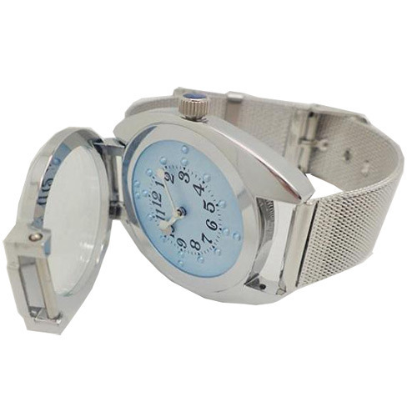
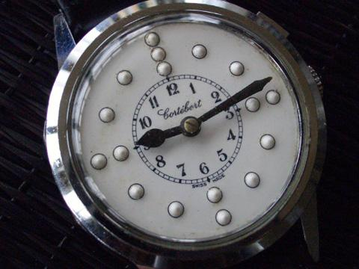
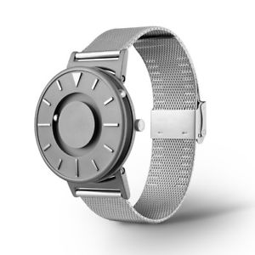
Problem
The main problem with the digital braille watch market is that is doesn’t exist…
There are only ideas, sketches, and very few prototypes
Braille watches can only be found in the analog variety

Slide 4
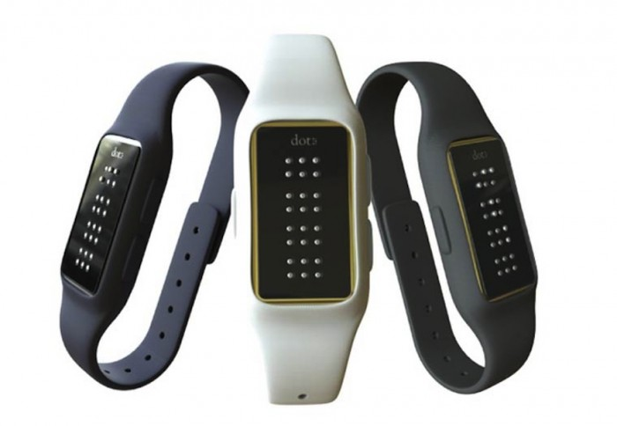
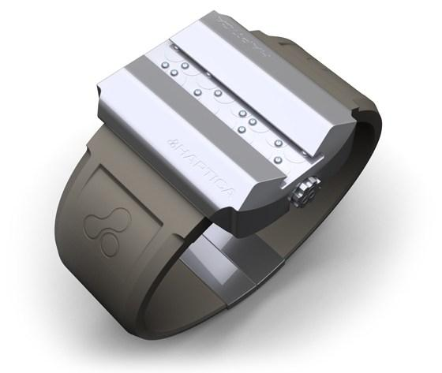
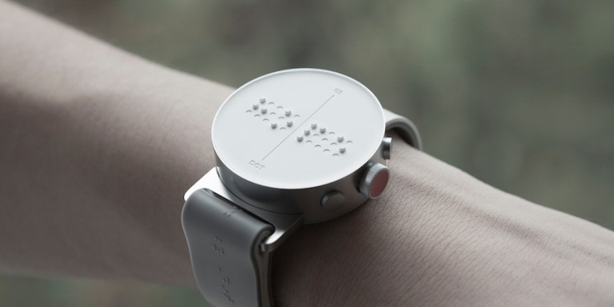
Competition
Since the market is solely focused on the analog variety of braille watches, the digital variety is open
This design is innovative and something that hasn’t been done before
As for pricing, it would not be drastically different than the current trends for watches

Slide 5
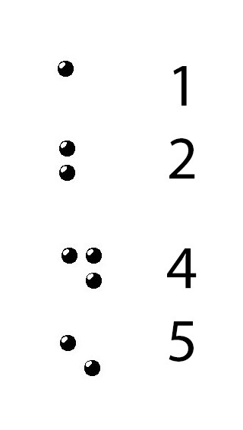
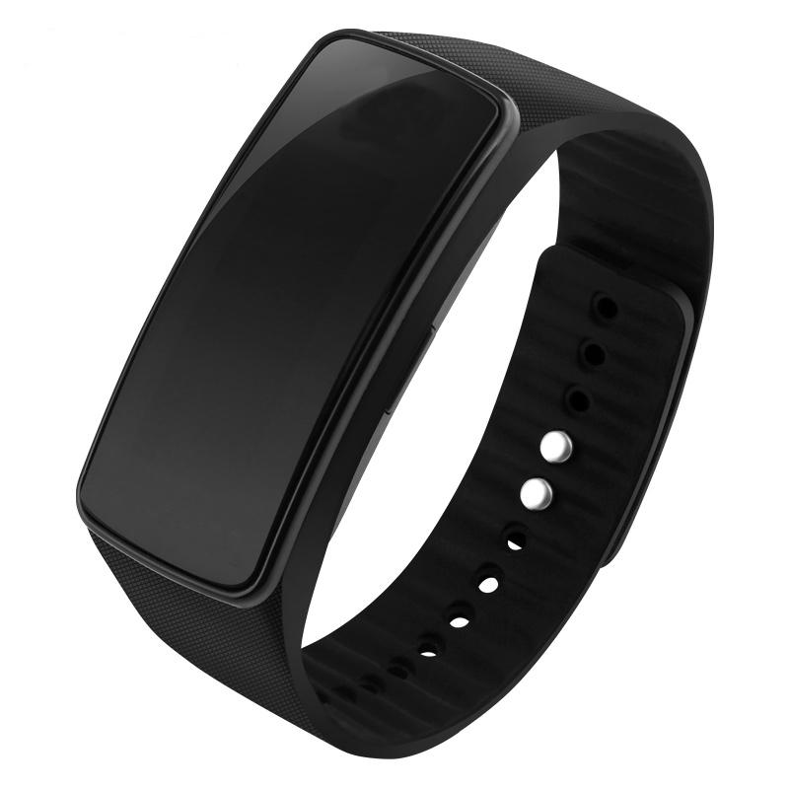
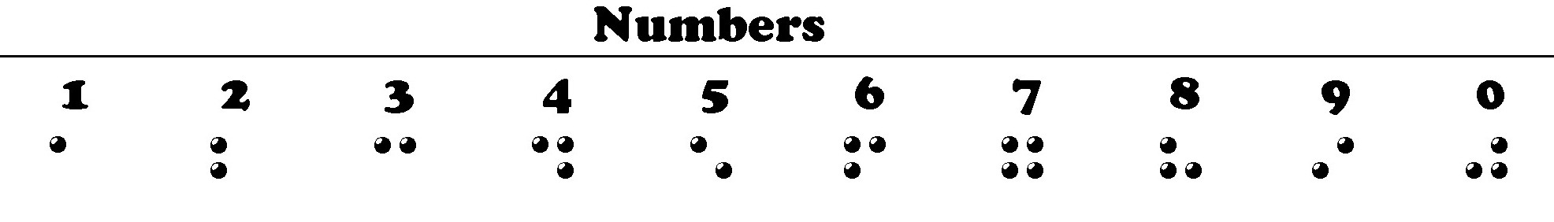
Description: Digital Braille Watch
First digital braille watch
Tune Mode
Adjust time
Military time vs regular
AM/PM indicator

Slide 6
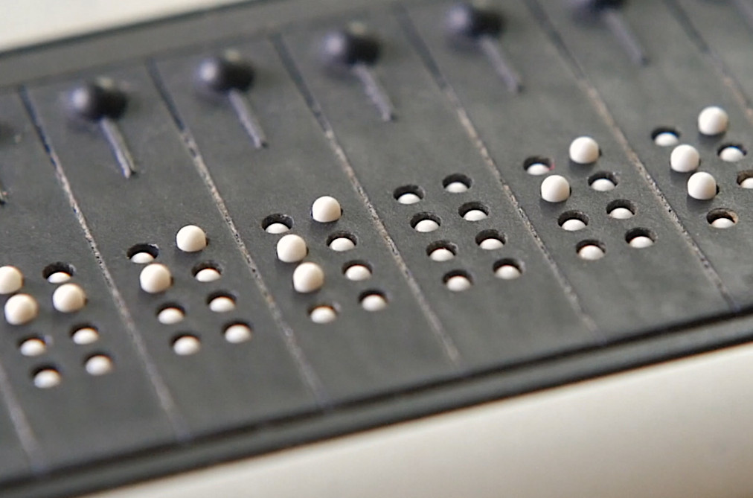
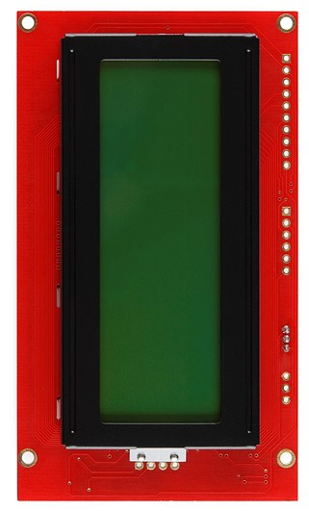
Description: Implementation
Mechanically update

Slide 7

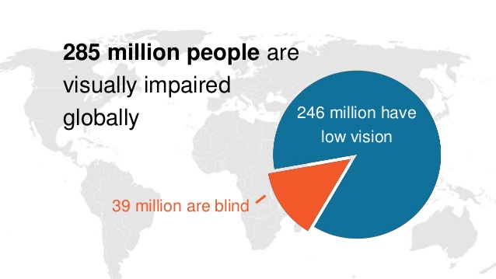
Our Market
The Blind and Visually Impaired

Slide 8
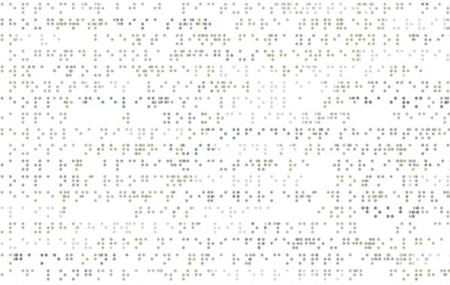
Why Will It Sell?
Novelty Effect
Appeals to the younger generations
Very little competition

Slide 9
Conclusion
Strong Market for this Product
Controller Implementable using VHDL
Useful for Millions of People

Slide 10
Questions?

Slide 11
Sources
https://www.indiamart.com/sparshproducts-dehradun/braille-wrist-watches.html
https://www.ebay.com/itm/Mens-Eutour-Unique-Luxury-Mens-Sport-Magnetic-Braille-Watch-/282732054670
http://www.swissvintagewatches.com/cortblind.html
http://www.designindaba.com/articles/creative-work/meet-dot-braille-smart-watch-visually-impaired
https://techcrunch.com/2011/02/04/help-make-this-wild-braille-watch-a-reality/
https://www.popularmechanics.com/technology/gadgets/a18605/dot-smart-watch-designed-for-the-blind/
https://www.slideshare.net/InternationalCentreforEyeHealth/epidemiology-andvisualimpairment
http://www.icoph.org/news/news_detail/423/IAPB-Releases-Updated-Statistics-about-Blindness-and-Low-Vision.html
http://www.atelj.ch/blog/wp-content/uploads/2010/07/spots.jpg

